Slide 1
Validating Your Information Security Program (ISP 3 of 3)
Plan - Do - Check - Act

Slide 2
You’ve Planned Risk Reduction…
You’ve Implemented Controls…
Now what?

Slide 3
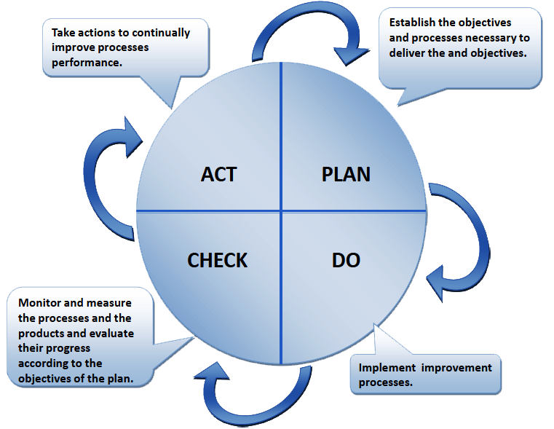
If You Don’t Validate (Check) Your Controls,
How Can You Be Confident That They Are Working to Reduce Risk?

Slide 4
So we need to validate
BUT HOW?

Slide 5
Proven ISP Validation Methods
Less-Technical
IT Audit
Moderately-Technical
Vulnerability Assessment
Automated Scanning
Highly Technical
Penetration Testing
Web & Mobile App Assessment

Slide 6
Method 1: IT Security Audit
Broad/General Audits
  Information Security Program (Policies, Procedures & Standards)
  Regulatory/Compliance (PCI, HIPAA, FFIEC FISMA/FedRAMP/NIST)
  Best Practice (CIS Top 20, ISO 27000, NIST)
Specific/Targeted Audits
  Firewall & Network Switch/Router Configuration & Policy
  Authentication, Authorization & Accounting (AAA)
  Remote Access
  Passwords
  Active Directory & Operating Systems (Windows, Linux)
Technical, Administrative/Operational, Physical

Slide 7
Method 2: Automated Scanning
Vulnerability Assessment
  Validates patch management and identifies well-known vulnerabilities, EOL software, default configurations, and default passwords
  Tools: Tenable Nessus, Rapid7 NeXpose, Qualys
Configuration Assessment
  Compares operating system configurations against industry best practices
  Tools: Tenable Nessus, Redseal, Titania Nipper
Application Assessment and Code Review
  Checks web applications for common and well-known flaws (OWASP Top 10)
  Tools: HP WebInspect, Burp Suite Pro, IBM AppScan

Slide 8
Method 3: Penetration Testing
Network – External
  Conducted from the Internet and simulates a skilled and determined intruder with intent on compromising your systems and data
Network – Internal
  Starts from a network connection on your internal network
Social Engineering
  Most common and most successful attack path for intruders
  Focus is not on tricking people, but instead on the flaws and vulnerabilities that an attacker takes post-compromise
  Email (phishing), telephone (pre-text calls), or onsite (physical)
Web & Mobile Applications (including APIs)
  Automated tools are great, but only in the hands of an experienced penetration tester
  The attack surface of most applications is 100x greater than most other network services

Slide 9
Modern & Advanced Methods
Adversary Simulation
  Based on pre-defined or customized playbook
    Command and control, persistence, discovery and credential access
    Privilege escalation and lateral movement
    Collection and exfiltration
    Defense evasion
  Typically performed onsite in Cooperation with our client’s Team
  Methodical, repeating process:
    Attack > Validate Control > Improve Control > Validate Control > Next Attack
  Tactics, techniques and procedures based on MITRE ATT&CK for Enterprise
Continuous Penetration Testing
  Most methods of validation are “point in time” and are conducted on 1-2 year cycles
  Continuous penetration testing shrinks the gap and provides regular validation throughout the entire year

Slide 10
Why independence matters

Slide 11
Experience Matters
It’s more than a 2nd set of eyes, but it is that too!
SynerComm’s consultants work with dozens of clients annually and come from diverse backgrounds
Proven and repeatable processes
One person can’t know it all, but a team of experts helps

Slide 12
Questions?
Thank You for Attending!

